Slide 1

Basics of computer and programming
CAP Technologies

Slide 2
what is computer
A computer is a programmable machine that processes data according to a set of instructions. It can perform a variety of tasks, ranging from simple calculations to complex computations. Computers consist of hardware components, such as the central processing unit (CPU), memory (RAM), storage devices (hard drives, solid-state drives), input/output devices (keyboard, mouse, monitor), and networking components (network interface cards, modems)

Slide 3
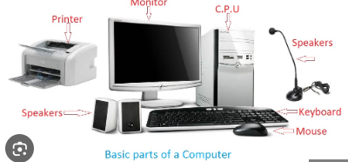
Parts of computer

Slide 4
Uses of computer
Communication
Education
Entertainment
Research
Business
Medicine
Finance
Design
Engineering
Gaming

Slide 5
Computer Generations
Computer generations refer to the different phases of development in computing technology. These generations are characterized by significant advancements and innovations in hardware, software, and architecture

Slide 6
First Generation (1940s-1950s):
Vacuum tubes were used as the primary electronic component.
Machines were large, expensive, and required a lot of electricity.
Examples include ENIAC and UNIVAC.
Second Generation (1950s-1960s):
Transistors replaced vacuum tubes, leading to smaller, faster, and more reliable computers.
Magnetic core memory was introduced.
Assembly language and high-level programming languages (such as FORTRAN and COBOL) emerged.

Slide 7
Third Generation (1960s-1970s):
Integrated circuits (ICs) enabled further miniaturization and increased computing power.
Mainframe computers became more accessible to businesses and institutions.
Time-sharing operating systems and high-level programming languages (such as BASIC and Pascal) were developed.
Fourth Generation (1970s-1980s):
Microprocessors were introduced, leading to the development of personal computers (PCs).
GUI (Graphical User Interface) and operating systems like MS-DOS and Unix were developed.
Networking technologies and the Internet started to evolve.
Fifth Generation (1980s-present):
VLSI (Very Large Scale Integration) technology enabled the creation of powerful microprocessors and memory chips.
Parallel processing and supercomputers became more prevalent.
Artificial Intelligence (AI), neural networks, and expert systems emerged as key areas of research.

Slide 8
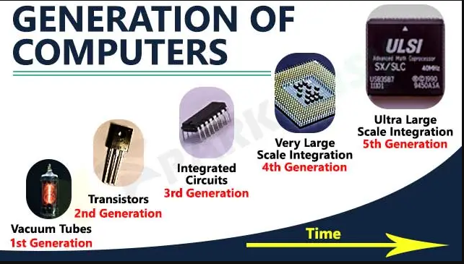

Slide 9
What is hardware
Hardware refers to the physical components of a computer or electronic device that you can touch and see. It includes things like the computer's central processing unit (CPU), memory (RAM), storage devices (hard drives, solid-state drives), input devices (keyboard, mouse, touchpad), output devices (monitor, printer, speakers), and networking equipment (network interface cards, routers).

Slide 10
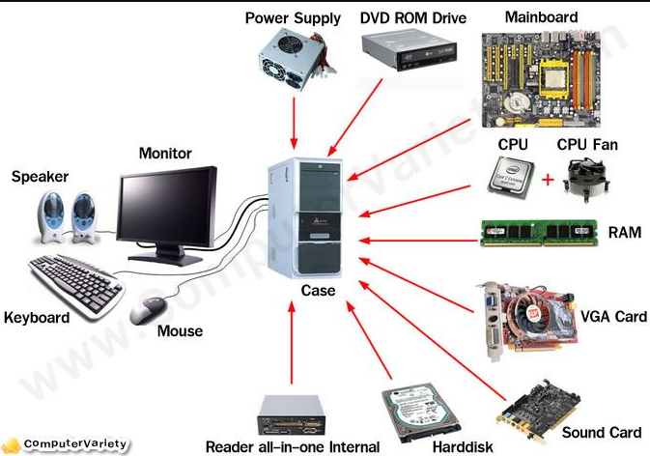
Some Hardware components

Slide 11
Uses of Hardware
Input
Processing
Memory
Storage
Output
Networking
Power
Cooling
Expansion
Security

Slide 12
What is software
Software refers to the programs, applications, and instructions that tell a computer or electronic device what to do. It's the non-tangible part of a computer system that you can't touch physically. Software includes everything from operating systems (like Windows, macOS, and Linux) to web browsers, games, word processors, and more.

Slide 13
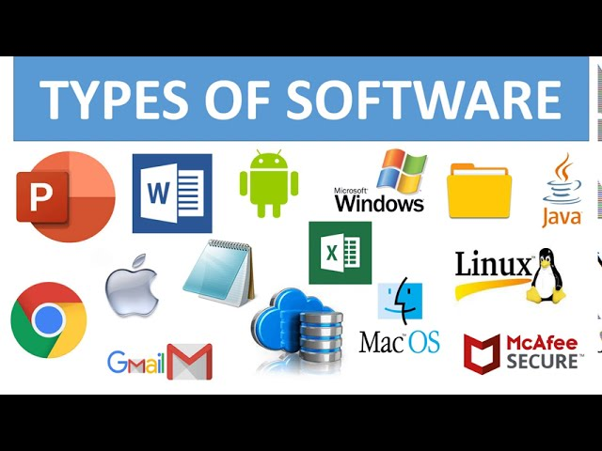
Some software

Slide 14
Uses of software
Productivity
Communication
Entertainment
Education
Gaming
Design
Development
Security
Automation
Analysis

Slide 15
What is Operating System
An operating system (OS) is a software program that manages a computer's hardware resources and provides common services for running applications. It acts as an intermediary between the user and the computer hardware, facilitating communication and coordination between various components.

Slide 16
Types of Operating System
Windows
macOS
Linux
Android
iOS
Unix
Chrome OS
FreeBSD
Ubuntu
CentOS

Slide 17
Uses of Operating System
Management
Coordination
Interface
Resource Allocation
Control
Communication
Security
Abstraction
Scheduling
Interoperability

Slide 18
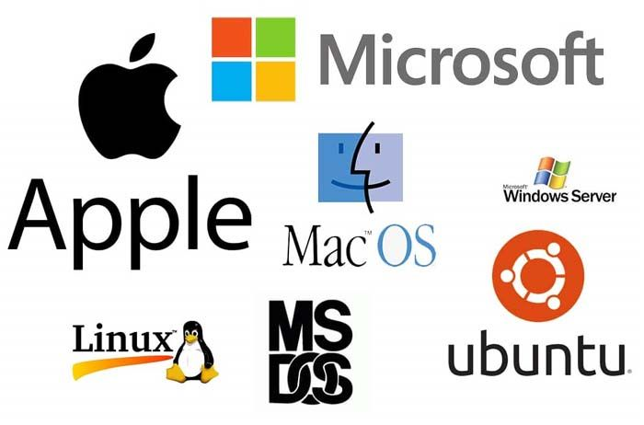

Slide 19
What is Windows
Windows is an operating system developed by Microsoft that runs on personal computers (PCs), laptops, tablets, and servers. It provides users with a graphical user interface (GUI) to interact with their computers and manage various tasks and applications.

Slide 20
What is Uses of windows
Computing
Productivity
Gaming
Communication
Entertainment
Education
Business
Development
Multimedia
Collaboration

Slide 21
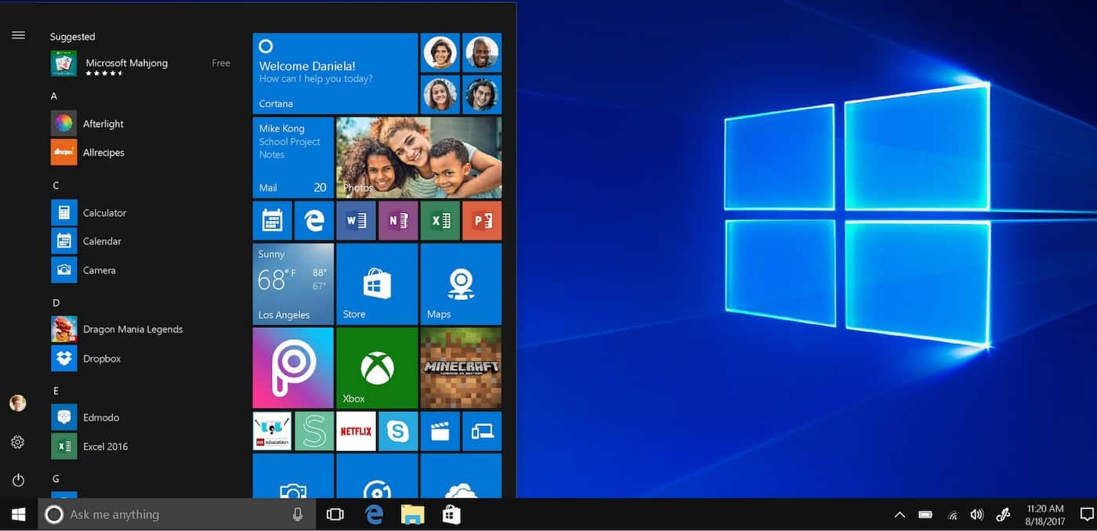

Slide 22
What is the difference between MAC, Windows, Linux
Windows: Developed by Microsoft, it's widely used and known for its user-friendly interface, compatibility with various software, and extensive support for gaming and productivity applications.
macOS: Developed by Apple for their Macintosh computers, known for its sleek design, integration with other Apple devices, and emphasis on creative applications and multimedia.
Linux: An open-source operating system with various distributions (like Ubuntu, Fedora, and CentOS), known for its flexibility, security, and extensive customization options, often used in servers and development environments.

Slide 23
What is CPU
In simple terms, the CPU, or Central Processing Unit, is like the brain of a computer. It's a small chip inside the computer that performs calculations, executes instructions, and manages data, allowing the computer to perform tasks like running programs, processing information, and interacting with users.

Slide 24
Uses of CPU
Computation
Processing
Calculation
Execution
Control
Tasking
Operations
Interpretation
Management
Coordination

Slide 25
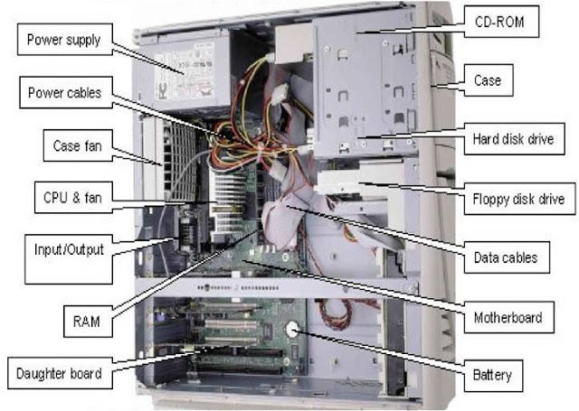
Inside CPU

Slide 26
Part 1 end

Slide 27
What is internet
In simple terms, the internet is like a giant network of computers all over the world that are connected to each other. It allows people to share information, communicate, and access all sorts of content like websites, videos, and pictures. Just like roads connect different places, the internet connects computers, phones, tablets, and other devices so they can send and receive data from one another. It's basically a superhighway of information that lets us do things like send emails, watch videos, play games, and so much more, all with just a few clicks or taps.

Slide 28
What is the use of internet
Connection

Slide 29
what is processor
A processor, also known as a central processing unit (CPU), is the "brain" of a computer. It's a small electronic chip inside the computer that carries out instructions and performs calculations necessary for the computer to function. The processor is responsible for tasks like executing programs, handling input/output operations, and managing data processing. In essence, it's the component that processes information and performs operations at high speed, enabling the computer to perform tasks efficiently.

Slide 30
What is the use of processor
In simple terms, the processor is like the brain of a computer. It's responsible for doing all the thinking and calculations necessary to make the computer work. Just like how your brain helps you think, process information, and perform tasks, the processor does the same for the computer. It helps run programs, handle tasks like browsing the internet or playing games, and makes sure everything happens smoothly and quickly.

Slide 31
What is primary and secondary memory
- Primary memory (RAM) is fast, volatile, and directly accessed by the CPU for temporary storage of data actively being processed.
- Secondary memory (HDD, SSD, etc.) is slower, non-volatile, and used for long-term storage of data that doesn't need to be accessed frequently.

Slide 32
What is RAM
RAM, which stands for Random Access Memory, is like a short-term memory for your computer. It's where the computer stores data and programs that it's currently using. When you open a program or a file, the computer loads it into RAM so it can access it quickly. RAM allows the computer to access and work with data much faster than it could if it had to rely solely on the hard drive. Think of it as a desk space where you keep papers and documents while you're working on them – it's temporary storage that helps you do your tasks more efficiently.

Slide 33
What is use of RAM
1. Provides quick access to data and programs currently in use.
2. Enables multitasking by allowing multiple programs to run simultaneously.
3. Stores frequently accessed data for faster retrieval.
4. Facilitates smooth operation of the computer's operating system.
5. Acts as temporary storage for program instructions and data.
6. Enhances overall system performance by providing fast data access.

Slide 34
What is ROM
ROM stands for Read-Only Memory. In simple terms, it's a type of computer memory that stores information that doesn't change or needs to be permanently saved. Unlike RAM (Random Access Memory), which is temporary and erased when the computer is turned off, ROM retains its data even when the computer loses power. It's used to store essential instructions and data that are necessary for the computer to start up and perform basic operations, such as the BIOS (Basic Input/Output System) and firmware. Think of it like a book that's already been written and can't be changed; it holds important information that the computer needs to function properly.

Slide 35
What is use of ROM
The use of ROM can be summarized in the following single point:
- Stores essential instructions and data necessary for the computer's startup and basic operations.

Slide 36
What is Virus
In short:
- A virus is a type of malicious software that can replicate itself and spread to other files or computers. It's designed to disrupt normal computer operation, steal information, or harm data.

Slide 37
What is the use of antivirus
In short:
- An antivirus is a software program designed to detect, prevent, and remove viruses and other malicious software from a computer. It scans files and monitors system activity to identify and neutralize threats.
Example: Norton Antivirus, McAfee Antivirus, Avast Antivirus.

Slide 38
Security system in Computer
Computer security systems are designed to protect computer systems, networks, and data from unauthorized access, damage, or theft. These systems encompass various tools, techniques, and protocols to ensure the confidentiality, integrity, and availability of information
Firewall: Check the Windows Firewall settings to ensure it is enabled and configured correctly. Go to Control Panel > System and Security > Windows Defender Firewall to review firewall settings.

Slide 39
What is SSD
SSD stands for Solid State Drive.
It's a type of storage device that uses integrated circuit assemblies as memory to store data persistently.
Unlike traditional hard disk drives (HDDs), SSDs have no moving mechanical components, resulting in faster data access and lower power consumption.
SSDs are commonly used in computers and electronic devices for their speed, reliability, and durability.

Slide 40
What is the use of SSD
Faster Boot Times: SSDs enable quicker system startup times compared to traditional HDDs.
Speedier Data Access: SSDs offer faster read and write speeds, improving overall system performance.
Improved Application Performance: Applications load faster and run more smoothly with SSD storage.
Enhanced Gaming Experience: SSDs reduce loading times in games, leading to a smoother gaming experience.
Increased Productivity: SSDs contribute to faster file transfers and quicker access to files, boosting productivity.
Durability and Reliability: SSDs are more resistant to physical shock and damage than HDDs due to their lack of moving parts.
Energy Efficiency: SSDs consume less power than HDDs, leading to longer battery life in laptops and lower energy costs in desktops.
Compact Form Factor: SSDs are available in smaller form factors, making them suitable for use in thin and lightweight devices such as ultrabooks and tablets.

Slide 41
Hardisk vs SSD
In short:
- Hard Disk Drive (HDD) uses spinning magnetic disks to store data, while Solid State Drive (SSD) uses flash memory chips.
- HDDs are slower and have moving parts, whereas SSDs are faster and more durable due to their lack of moving components.
- SSDs provide quicker boot times, faster data access, and better overall system performance compared to HDDs.
- HDDs typically offer higher storage capacities at a lower cost per gigabyte, while SSDs are more expensive but offer faster performance and greater reliability.

Slide 42
Graphic card
In short:
- A graphics card, also known as a GPU (Graphics Processing Unit), is a specialized computer chip responsible for rendering images, videos, and animations on a display.
- It accelerates the rendering of graphics by performing complex calculations and rendering tasks.
- Graphics cards are essential for gaming, video editing, graphic design, and other tasks that require intensive graphical processing.
- They come in various models with different levels of performance and features to meet the demands of different applications and users.

Slide 43
Mother board
In short:
- The motherboard is the main circuit board of a computer.
- It houses and connects crucial components such as the CPU, memory, storage devices, and expansion cards.
- It provides communication pathways and power distribution to these components, enabling them to work together.
- The motherboard determines the compatibility and performance of a computer system.

Slide 44
UPS and its Uses
In short:
- UPS stands for Uninterruptible Power Supply.
- It's a backup power source that provides instant, temporary power during electrical outages or fluctuations.
- UPSs are commonly used to protect sensitive electronic equipment such as computers, servers, and networking devices from power surges, sags, or complete power loss.
- They ensure uninterrupted operation, prevent data loss, and protect against hardware damage by providing a buffer between the device and the main power supply.

Slide 45
Wifi and its uses
In short:
- WiFi is a wireless networking technology that allows devices to connect to the internet and communicate with each other over a local area network (LAN).
- It uses radio waves to transmit data between devices, eliminating the need for physical wired connections.
- WiFi is commonly used in homes, offices, public spaces, and other environments to provide internet access to computers, smartphones, tablets, and other wireless devices.
- Its uses include accessing the internet, sharing files and printers, streaming media, online gaming, and enabling IoT (Internet of Things) devices to connect to a network.

Slide 46
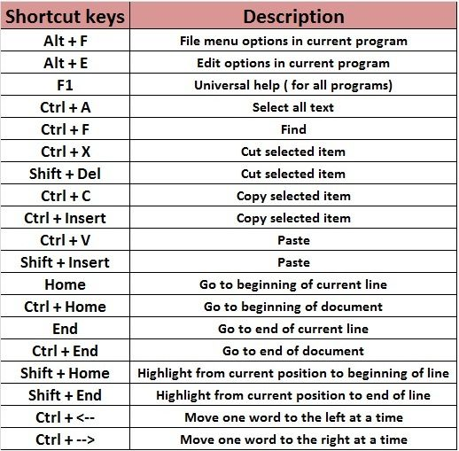
shortcut keys

Slide 47
Google
In short:
Google is a multinational technology company known primarily for its internet-related products and services. It was founded in 1998 by Larry Page and Sergey Brin while they were students at Stanford University. Google's core products include its search engine, which is one of the most widely used tools for finding information on the internet. Additionally, Google offers various other services such as Gmail (email), Google Maps, Google Drive (cloud storage), YouTube (video sharing), and the Android operating system for mobile devices. Google has also ventured into hardware with products like Pixel smartphones, Google Home smart speakers, and Nest smart home devices.

Slide 48
What is chrome
In short:
Chrome is a web browser developed by Google. It was first released in 2008 and has since become one of the most popular browsers worldwide. Chrome is known for its speed, simplicity, and user-friendly interface. It supports a wide range of features, including tabbed browsing, bookmarks, synchronization across devices, and built-in security features such as safe browsing and automatic updates. Chrome also supports extensions and web apps, allowing users to customize their browsing experience and access additional functionality.

Slide 49
What is Email
In short:
Email, short for electronic mail, is a method of exchanging digital messages between individuals or groups using electronic devices connected to the internet. It allows users to send, receive, and store messages containing text, attachments, images, and other multimedia content. Email is widely used for communication in both personal and professional contexts, providing a convenient and efficient means of correspondence over long distances and time zones.

Slide 50
Gmail
In short:
Gmail is a free email service provided by Google. It was launched in 2004 and has since become one of the most popular email platforms worldwide. Gmail offers features such as a large storage capacity, powerful spam filtering, customizable organization with labels and filters, integration with other Google services like Google Drive and Google Calendar, and access to email via web browsers or mobile apps. It also provides a user-friendly interface and supports features like conversation threading and keyboard shortcuts to enhance productivity.

Slide 51
Features of Gmail
In short:
1. **Large Storage**: Offers generous storage space for emails and attachments.
2. **Search**: Powerful search functionality to quickly find emails or information.
3. **Organization**: Tools like labels, filters, and folders to organize emails effectively.
4. **Integration**: Seamless integration with other Google services like Drive, Calendar, and Meet.
5. **Security**: Advanced spam filtering and robust security features to protect against threats.

Slide 52
Uses of Gmail
Email Communication: Use Gmail to send and receive emails to individuals and groups.
Organize Emails: Organize emails using labels, folders, and filters to keep your inbox tidy and easy to navigate.
Large Storage: Take advantage of Gmail's large storage capacity to store a vast amount of emails and attachments.
Search Functionality: Utilize Gmail's powerful search feature to quickly find specific emails or information within your inbox.
Integration with Google Services: Seamlessly integrate Gmail with other Google services such as Google Drive, Google Calendar, and Google Meet.

Slide 53
Secure Gmail
Live demo

Slide 54
Monitor your device
Live Demo

Slide 55
How do I Build my own PC

Slide 56
Part 2 end

Slide 57
What is Machine level Language
Machine language, in simple terms, refers to the lowest-level programming language understood by computers directly. It consists of binary code, which is a series of 0s and 1s representing instructions that the computer's CPU can execute directly. Each instruction corresponds to a specific operation or task that the CPU can perform, such as adding two numbers or moving data between memory locations. Machine language is difficult for humans to read and write because it's entirely composed of binary digits, but it's the language that all computer programs ultimately get translated into before being executed by the computer hardware.

Slide 58
What is the use of Machine Level language
Execution
Processing
Control
Operation
Direct
Communication
Interpretation
Integration
Fundamental
Efficient

Slide 59
What is high level language
high-level languages are like a set of instructions written in a language that's easier for people to understand, which gets translated into machine code (the language that computers understand directly) by special software called compilers or interpreters. Examples of high-level languages include Python, Java, C++, and JavaScript.

Slide 60
What is the use of High level Language
Abstraction
abstraction means simplifying things by hiding the unnecessary details, making it easier for developers to work with and understand complex systems or concepts.

Slide 61
What is coding
In short:
Coding, also known as programming, is the process of writing instructions in a specific programming language to create software, websites, apps, and other digital products. It involves using logical reasoning and syntax to develop algorithms and commands that computers can understand and execute to perform desired tasks or functions. Coding is the foundation of computer science and technology, enabling developers to bring ideas to life and solve complex problems through software development.

Slide 62
What is programming
In short:
Programming is the process of creating sets of instructions, known as code, that tell a computer how to perform tasks or solve problems. Programmers use programming languages to write code, which is then translated into machine-readable instructions by a computer. Programming is a fundamental skill in computer science and is used to develop software, websites, apps, and other digital solutions.

Slide 63
What is difference between programming and coding
Coding:
Coding refers to the process of writing lines of code in a specific programming language.
It typically involves translating design concepts or algorithms into a textual form that a computer can understand and execute.
Coding often implies the act of writing individual lines or segments of code to perform specific tasks or functions.
It can be seen as a narrower activity focused on the implementation aspect of programming.
Programming:
Programming encompasses a broader set of activities beyond just writing code.
It involves designing, planning, implementing, and testing software solutions to solve problems or accomplish tasks.
Programming includes activities such as problem-solving, algorithm design, software architecture, debugging, and testing in addition to coding.
It involves understanding the problem domain, breaking it down into manageable parts, and creating an overall solution.

Slide 64
WHAT IS THE USE OF PROGRAMMING
In short:
Programming languages are used to write instructions or code that computers understand and execute to perform tasks or solve problems.
They provide a way for developers to communicate with computers and create software, websites, apps, and other digital solutions.
Programming languages enable developers to automate tasks, manipulate data, create algorithms, and build complex systems, enhancing productivity and innovation in various fields.

Slide 65
Platform for programming

Slide 66
What is full stack web developing
Full-stack web development refers to the practice of developing both the front-end (client-side) and back-end (server-side) components of a web application. A full-stack developer is proficient in working with both the front-end technologies, such as HTML, CSS, and JavaScript, and the back-end technologies, such as databases, servers, and server-side programming languages.

Slide 67
What is app development
Full-stack app development refers to the process of building an application that includes both the front-end (client-side) and back-end (server-side) components. A full-stack app developer is proficient in developing all aspects of an application, from designing the user interface to implementing server-side logic and managing databases.

Slide 68
What is AI
In short:
AI stands for Artificial Intelligence.
It refers to the simulation of human intelligence in machines, enabling them to perform tasks that typically require human-like cognitive functions such as learning, problem-solving, and decision-making.
AI encompasses various subfields such as machine learning, natural language processing, computer vision, and robotics, among others.
It is used in a wide range of applications including virtual assistants, autonomous vehicles, healthcare diagnostics, recommendation systems, and more, to enhance efficiency, accuracy, and automation in various domains.

Slide 69
Fundamentals of programming

Slide 70
Logic behind programming
In short:
The logic behind programming involves creating a sequence of instructions that a computer can follow to solve a problem or perform a task.
It requires breaking down complex problems into smaller, manageable steps and using logical reasoning to design algorithms and commands.
Programmers use control structures like loops, conditionals, and functions to control the flow of execution and make decisions within a program.
By applying logical thinking and problem-solving skills, programmers develop efficient and effective solutions to a wide range of problems through programming.

Slide 71
Syntax
In short:
Syntax refers to the rules and structure governing the arrangement of symbols, characters, and words in a programming language.
It dictates how code must be written to be considered valid and understandable by the compiler or interpreter.
Syntax errors occur when code violates these rules, leading to compilation or execution failures.
Understanding and adhering to syntax rules is essential for writing correct and functional code in programming languages.

Slide 72
Variable, function, identifier, object oriented programming
In short:
- **Variable**: A variable is a symbolic name that represents a value stored in computer memory. It can hold different types of data, such as numbers, text, or objects, and its value can change during program execution.
- **Function**: A function is a self-contained block of code that performs a specific task or calculation. It can take input parameters, perform operations, and return a result. Functions help organize code, promote reusability, and improve readability.

Slide 73
- **Identifier**: An identifier is a name used to identify variables, functions, classes, or other entities in a program. Identifiers follow naming conventions and rules specific to the programming language, such as using letters, digits, and underscores, and cannot start with a digit.
- **Object-Oriented Programming (OOP)**: Object-oriented programming is a programming paradigm based on the concept of "objects," which represent real-world entities and encapsulate data and behavior. OOP promotes modularity, reusability, and extensibility by organizing code into classes and objects, which interact with each other through methods, properties, and inheritance.

Slide 74
Interpreters
In short:
- **Interpreter**: An interpreter is a program that translates and executes source code line by line, immediately converting high-level code into machine code and executing it on the fly. Unlike a compiler, which generates an independent executable, an interpreter does not produce a separate output file; instead, it interprets and executes the code directly.

Slide 75
Compiler
- **Compiler**: A compiler is a program that translates source code written in a high-level programming language into machine code or an intermediate representation. It performs this translation all at once, generating an executable file that can be run independently of the compiler.

Slide 76
How to setup environment

Slide 77
Algorithm
An algorithm is a step-by-step procedure or set of rules designed to solve a specific problem or perform a particular task. It outlines the sequence of actions or operations required to achieve a desired outcome. Algorithms are used in various fields, including mathematics, computer science, engineering, and everyday life, to solve problems efficiently and systematically. They are fundamental to computer programming and serve as the foundation for developing software and designing algorithms for tasks such as sorting data, searching for information, or solving complex computational problems.

Slide 78
What's the purpose of algorithm
In short:
The purpose of an algorithm is to provide a systematic and efficient method for solving a specific problem or performing a task.
It outlines a sequence of steps or instructions that, when followed, lead to the desired outcome.
Algorithms are used in various fields, including computer science, mathematics, engineering, and everyday life, to automate processes, optimize solutions, and solve complex problems.

Slide 79
How does programming help in feature
In short:
- **Problem-Solving Skills**: Programming enhances problem-solving abilities by teaching logical thinking and systematic approaches to addressing challenges.
- **Versatility**: Programming skills are applicable across various industries and domains, offering diverse career opportunities in technology, finance, healthcare, entertainment, and more.
- **Innovation and Creativity**: Programming empowers individuals to create innovative solutions, develop new technologies, and contribute to advancements in society.
- **Automation and Efficiency**: Programming enables automation of tasks, streamlining processes, improving efficiency, and reducing manual labor.

Slide 80
- **Critical Thinking**: Programming fosters critical thinking skills by requiring analysis, evaluation, and optimization of code and algorithms.
- **Global Collaboration**: Programming facilitates collaboration and communication with individuals worldwide, fostering global connections and teamwork.
- **Adaptability**: Programming teaches adaptability, as technologies and programming languages evolve, requiring continuous learning and skill development.
- **Financial Opportunities**: Proficiency in programming can lead to lucrative career opportunities, with high demand and competitive salaries in the tech industry.
- **Empowerment**: Programming empowers individuals to create their own digital solutions, build businesses, and pursue entrepreneurial ventures.
- **Problem-Solving for Social Impact**: Programming can be used to address societal challenges, such as poverty, education, healthcare, and environmental sustainability, contributing to positive social change.

Slide 81
Basic programming language
Basic Programming Languages:
1. Python
2. JavaScript
3. HTML/CSS
4. Java
5. Scratch
6. C
7. Swift
8. SQL

Slide 82
Basics of Microsoft Office
Microsoft Office is a suite of productivity software developed by Microsoft. It includes applications such as Word (for word processing), Excel (for spreadsheets), PowerPoint (for presentations), Outlook (for email and calendar management), Access (for database management), and more. Microsoft Office is widely used in both personal and professional settings for creating documents, analyzing data, delivering presentations, and managing communications.

Slide 83
Microsoft office Course Detailed

Slide 84
Any queries ? Thank you
Contact: +91 8940940853
Instagram :@captech2024
Facebook: Captech Ghm
Email: captech2024@gmail.com

